Slide 1

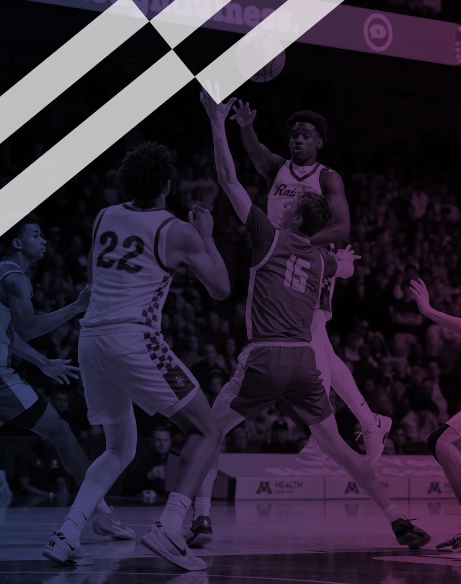

2026-27 NFHS
Basketball Rules
PowerPoint
Rules Changes Editorial Changes Points of Emphasis
Copyright© 2026 National Federation of State High School Associations. All Rights Reserved.
This copyrighted power point is presented by the NFHS. This material shall only be reproduced or distributed by member state associations for teaching and training purposes. Distribution to the public is prohibited without the express written consent from the NFHS. Please contact Davis Whitfield, COO at dwhitfield@nfhs.org with requests.
Notes:
Welcome the group; this session walks through the 2026-27 NFHS basketball rules changes, editorial changes, and points of emphasis.
Remind attendees this material is copyrighted and for member state association teaching and training only.
Frame the goal: consistent interpretation and enforcement on the court this season.

Slide 2
NFHS Information
Notes:
Quick background on the NFHS before we get into the rules.

Slide 3
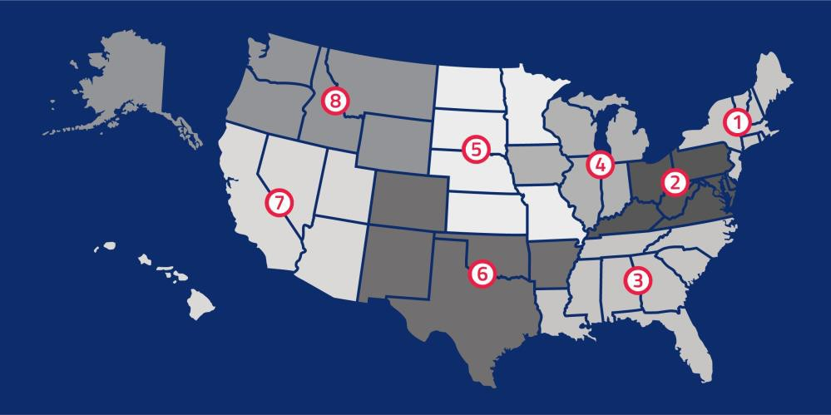
NFHS
NFHS (located in Indianapolis, IN – Est. 1920):
  National leader and advocate for high school
athletics and performing arts programs.
  Serves 51 state associations, 19,983 high
schools and 12 million student participants.
  Writes playing rules for 18 high school
sports for boys and girls.
  Offers online education courses for high
school coaches, officials, parents, students and others.
  Ensures that students have opportunity to enjoy healthy participation,
achievement and good sportsmanship in education-based activities.
Notes:
NFHS (Indianapolis, est. 1920) is the national rules authority for high school athletics and performing arts.
It serves 51 state associations, nearly 20,000 schools, and 12 million students, and writes rules for 18 sports.
Its mission is safe, fair, education-based participation and good sportsmanship.

Slide 4





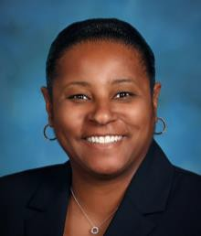

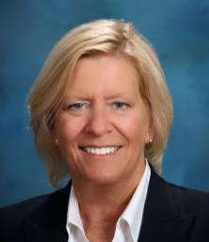

NFHS Rules Review Committee
The NFHS Rules Review Committee is chaired by the chief operating officer and composed of all rules editors. After each committee concludes its deliberations and has adopted its recommended changes for the subsequent year, such revisions will be evaluated by the Rules Review Committee.
Davis Whitfield | Lindsey Atkinson | Julie Cochran | Bob Colgate | Elliot Hopkins | Monica Maxwell | Dan Schuster | Sandy Searcy | Chris Paulson
Chief Operating | Boys & Girls Lacrosse | Cross Country, Soccer | Flag Football, | Baseball and | Basketball, Field | Ice Hockey | Softball, Swimming & | Spirit
Officer | and Volleyball | and Track & Field | Football and Sports | Wrestling | Hockey and Girls |  | Diving and Water Polo
 |  |  | Medicine |  | Gymnastics
Notes:
The COO chairs the Rules Review Committee, made up of all sport rules editors.
Each committee's adopted changes are reviewed here for consistency across sports.
Monica Maxwell is the basketball rules editor contact.

Slide 5


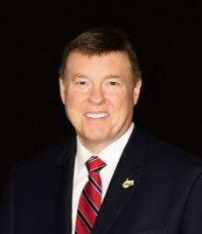
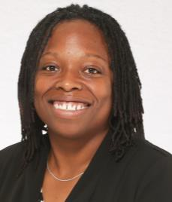
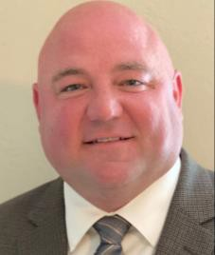
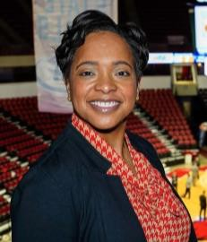
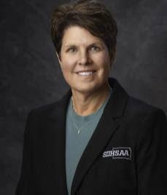

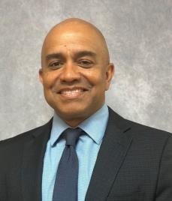


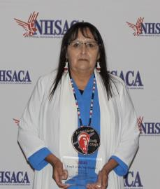
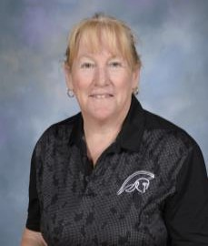

NFHS Rules Committee
Ben Boothe Lenexa, KS Chair - 2029
TJ Halliday Waterville, ME Section 1 - 2028
Wayne Ryan Parkersburg, WV Section 2 - 2029
Sarah Hayes Columbia, SC Section 3 - 2028
Brian Lewis Indianapolis, IN Section 4 - 2026
Ashley Logan River Forest, IL Section 4 - 2029
Kristina Sage Pierre, SD Section 5 - 2029
Joseph Garmon Austin, TX Section 6 – 2027
Lenny Hatchett Oklahoma City, OK Section 6 - 2027
Lisa Bishop Las Vegas, NV Section 7 - 2026
Missy Smith Wilsonville, OR Section 8 - 2027
Aleta Moss Ethete, WY Section 8 - 2028
Mary Klinger
Somerset, NJ
NFHS Coaches - 2026
Tracy Black
Fishers, IN
NFHS Officials - 2029
Notes:
Introduce the 2026 Basketball Rules Committee: coaches, officials, and state representatives across all sections.
Terms are staggered to keep continuity year to year.
These are the members who drafted and voted on this year's changes.

Slide 6


















NFHS Publications
The NFHS writes playing rules for 18 sports for boys and girls at the high school level.
  Publishes 2 million pieces of materials annually.
Notes:
The NFHS writes rules for 18 boys and girls sports and publishes about 2 million pieces of material annually.
Rules books, case books, and manuals are the official references for interpreters.

Slide 7

NFHS Digital
NFHS Digital is the digital publications platform for the NFHS. The app includes:
  Rules Books
  Case Books
  Officials Manuals
  Preseason Guide
  Policy Debate Quarterly
  Other NFHS Publications
Notes:
NFHS Digital is the platform hosting rules books, case books, officials manuals, and more.
Point attendees here as the single source for the publications they need.

Slide 8

NFHS Digital – Mobile App
NFHS Digital is available via mobile app (on App Store or Google Play) or as a desktop platform.
Features include:
  View publications for sale in the NFHS Digital Store
  View publications assigned to/purchased by you
  Create comments, save notes, and share!
  Highlight content to review later
  Visit https://nfhs.org/about/nfhs-digital
Notes:
Available as a mobile app on the App Store and Google Play, and as a desktop platform.
Officials can add comments, save notes, highlight, and share content.
Encourage everyone to download it and use it while studying the rules.

Slide 9
2026 NFHS Basketball Rules Changes
Notes:
Transition slide: we are now moving into the 2026-27 rules changes.

Slide 10

RE-STARTING THE CLOCK 5-9-5 (NEW)
RULES CHANGES
In the last 59.9 seconds of each quarter or extra period, if play is to be resumed by a throw-in or an unsuccessful free throw, a minimum of 3/10ths (.3) of a second must expire on the game clock when the ball is legally touched by a player inbounds
Notes:
New rule: in the last 59.9 seconds of a quarter or overtime, at least 0.3 seconds must elapse on a throw-in or missed free throw before a scoring play can count.
This prevents impossible catch-and-shoot situations.
Officials must know when to run time off the clock.

Slide 11
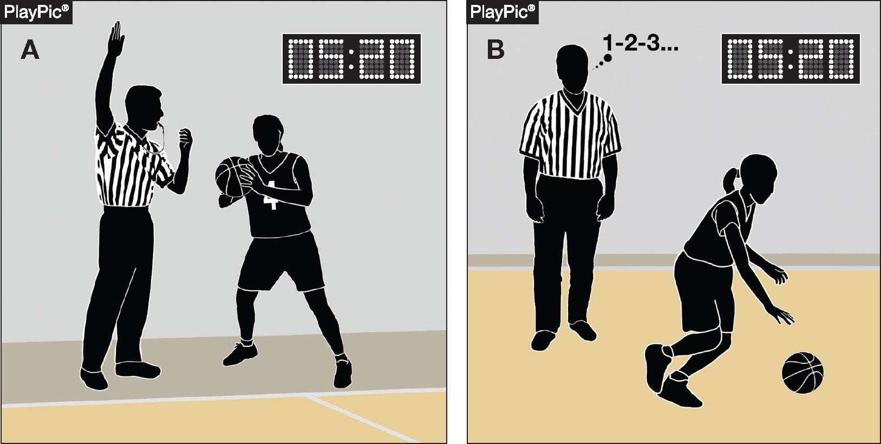
TIMING MISTAKES 5-10-2 NOTE (NEW)
RULES CHANGES
If the referee determines the clock malfunctioned or was not started/stopped properly, or if the clock did not run, an official's count, visible or silent, or other official information may be used to make a correction
Notes:
New: if the clock malfunctions or is not started or stopped properly, officials may use a count (visible or silent) or other official information to correct the time.
Reinforces the officials' authority to fix timing errors.

Slide 12
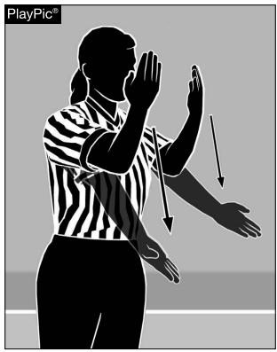
ALTERNATING POSSESSION 6-4-4g
RULES CHANGES
The letter ‘g’ is now eliminated
Play is stopped when there is team control, a goal is scored, or another official stoppage occurs. When play is properly stopped, the ensuing resumption is administered under the appropriate rule for the situation, rather than using the alternating possession procedure (Rule 4-36-2.c)
This is not a rule change; this was inadvertently left in the rule after the rule change in 2025-26
Notes:
The letter 'g' is eliminated, cleaning up language inadvertently left in after the 2025-26 change.
This is not a rule change; resume play under the appropriate rule, not alternating possession.

Slide 13
RESUMING PLAY DIFFERENCES 8-6-4a-d (NEW)
RULES CHANGES
ART 4…When, during the same dead-ball period that follows an infraction or stoppage in play and before the ball becomes live, both teams are assessed technical fouls:
All technical fouls are considered to have been committed at approximately the same time for the purposes of offsetting their penalties;
All fouls are charged, and their penalties are identified;
When there is an unequal number of fouls committed during the dead-ball period, play shall resume as if the last committed single administrative, team, substitute, player, or bench technical foul was the only foul committed; and
If, after the cancellation of the penalties for an equal number of fouls by both teams, the game shall be resumed at the point of interruption.
Notes:
New procedure for when both teams are assessed technical fouls in the same dead-ball period.
Offsetting techs are treated as committed at the same time; with an unequal number, resume as if only the last was called.
With an equal number, penalties cancel and play resumes at the point of interruption.

Slide 14
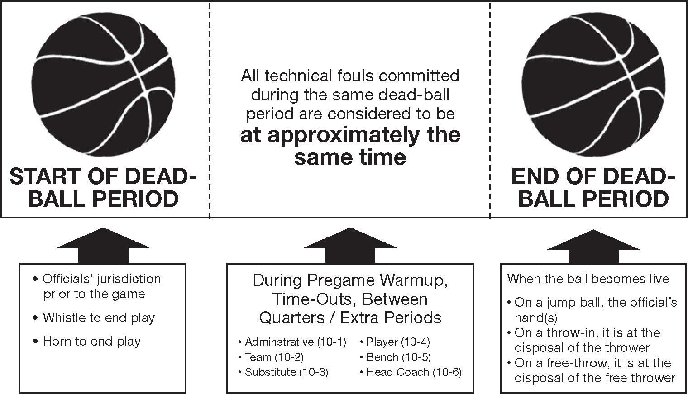
RESUMING PLAY DIFFERENCES 8-6-4a-d (NEW)
RULES CHANGES
All technical fouls committed during the same dead-ball period are considered to be at approximately the same time for purposes of offsetting their penalties
Play resumes at the point of interruption
Notes:
Key takeaway: all technicals in the same dead-ball period offset as if simultaneous.
Play then resumes at the point of interruption.

Slide 15
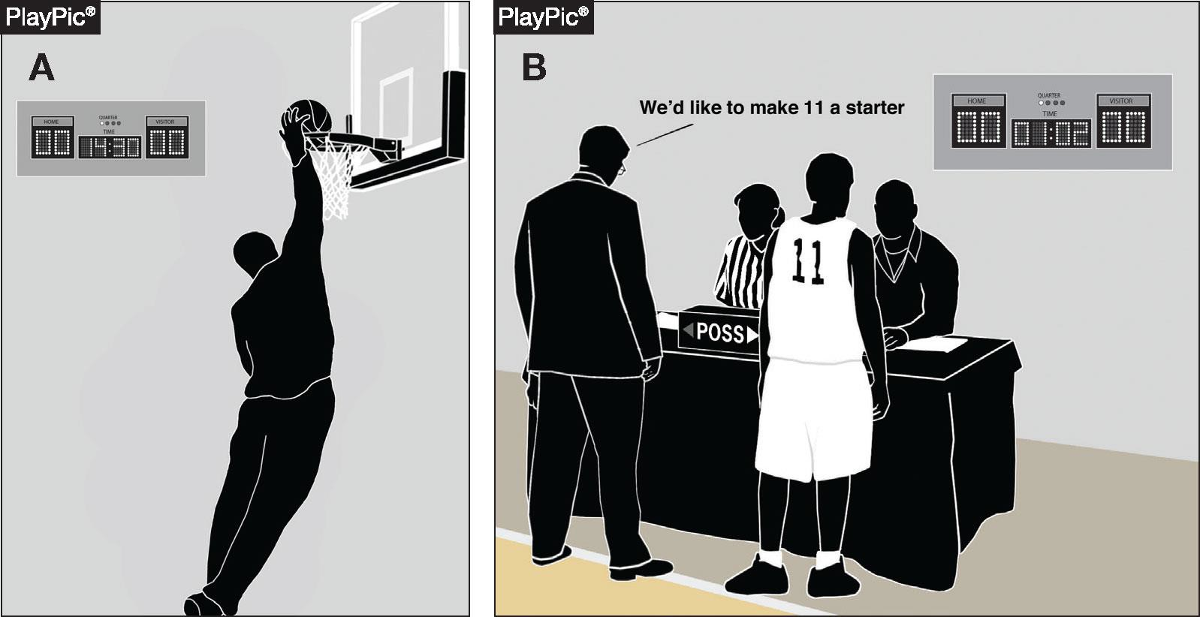
RESUMING PLAY DIFFERENCES 8-6-4a-d (NEW)
RULES CHANGES
While (A) and (B) occur more than 13 minutes apart in the pregame warmup, they are considered to be at approximately the same time for purposes of offsetting their penalties
Notes:
Example: fouls occurring more than 13 minutes apart in warmup still count as 'same time' for offsetting.

Slide 16
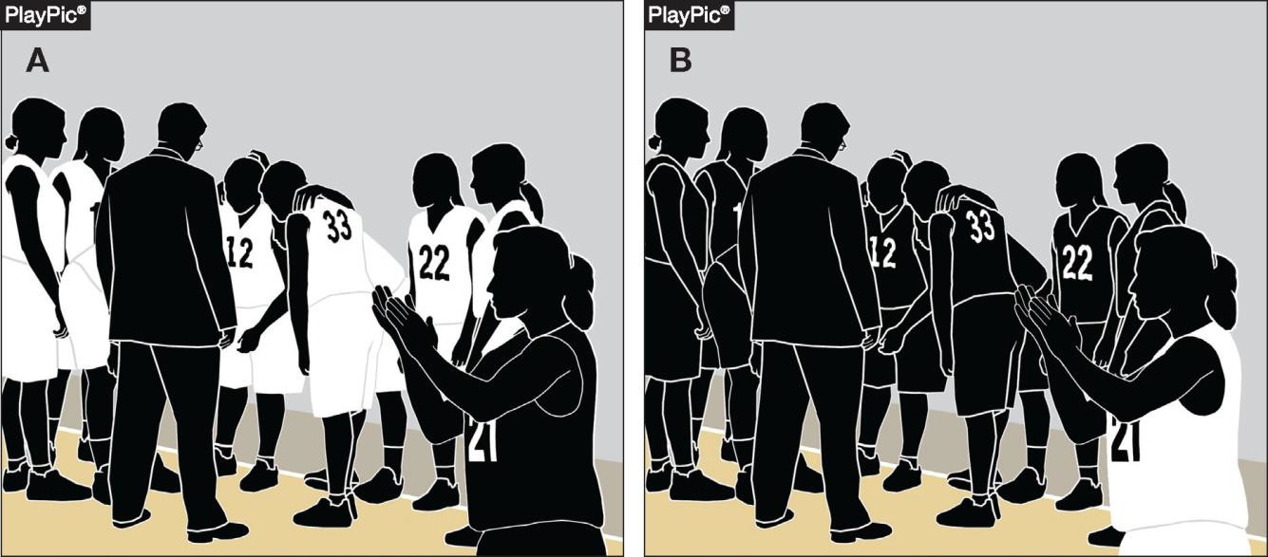
RESUMING PLAY DIFFERENCES 8-6-4a-d (NEW)
RULES CHANGES
Even though the unsporting technical fouls are committed at the start (A) and end (B) of the time-out, they are considered to be at approximately the same time for purposes of offsetting their penalties
Notes:
Example: unsporting technicals at the start and end of a time-out still offset as simultaneous.

Slide 17
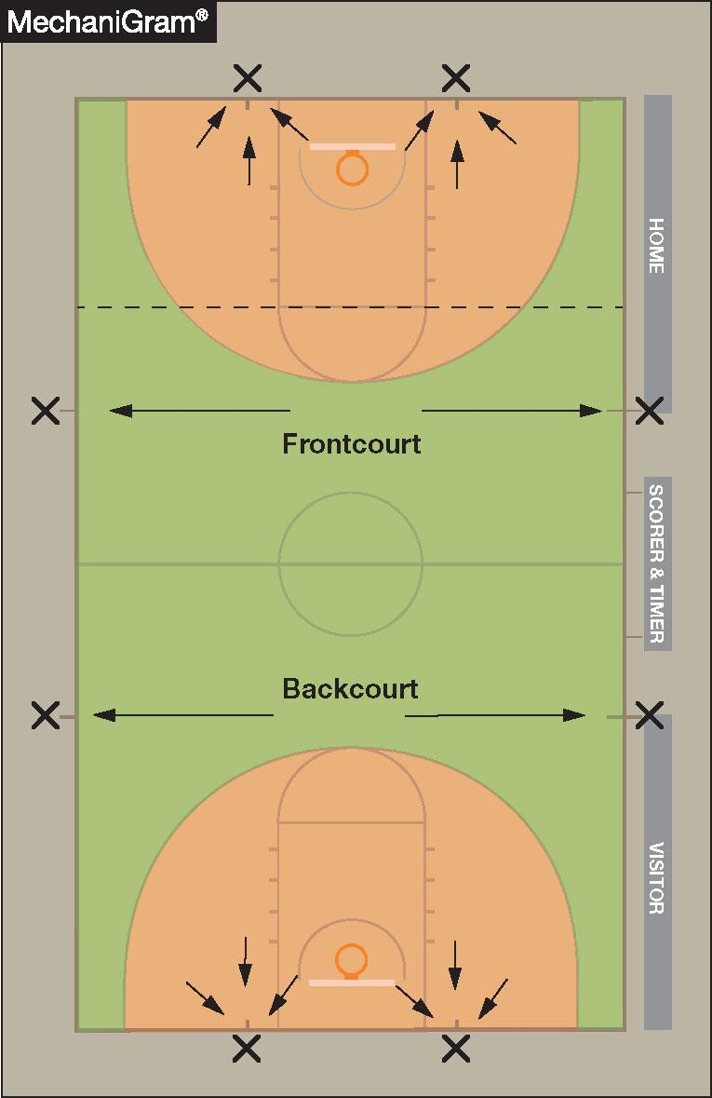
THROW-IN PROVISIONS 9-2 (PENALTY)
RULES CHANGES
When an infraction occurs on a throw-in, the location of the violation is the original throw-in spot
If the original throw-in spot is not a designated spot, the ensuing throw-in is moved to such a spot (as indicated in the diagram)
Notes:
A throw-in violation is spotted at the original throw-in location.
If that spot is not a designated spot, move the throw-in to the nearest designated spot.

Slide 18
2026 NFHS Basketball Editorial Changes
Notes:
Transition slide: these are editorial changes, clarifications rather than substantive rule changes.

Slide 19

ELECTRONIC DEVICES 1-19 NOTE (NEW)
EDITORIAL CHANGES
NOTE: Communication between a coach and player through electronic devices is prohibited
Hearing aids are legal
Notes:
Coach-to-player communication through electronic devices is prohibited.
Hearing aids remain legal.

Slide 20
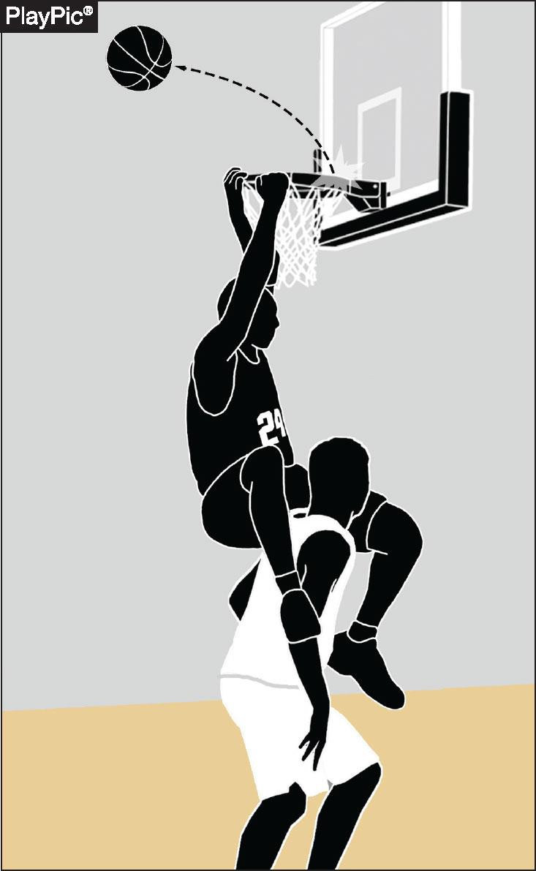
AIRBORNE SHOOTER
4-1-1 EXCEPTION (NEW)
EDITORIAL CHANGES
A player is not considered an airborne shooter when hanging on the rim after a dunk attempt
If the dunk attempt is successful, the ball becomes dead when it passes through the basket; any subsequent contact between the player who dunked the ball and an opponent shall be ignored unless the contact is ruled intentional or flagrant
If the dunk attempt is unsuccessful and the ball remains live, any illegal contact between the player who attempted the dunk and an opponent shall be ruled a common foul and administered according to the bonus situation
Notes:
A player hanging on the rim after a dunk attempt is not an airborne shooter.
Successful dunk: the ball is dead once through the basket; ignore later contact unless intentional or flagrant.
Unsuccessful dunk with a live ball: illegal contact is a common foul, administered per the bonus.

Slide 21
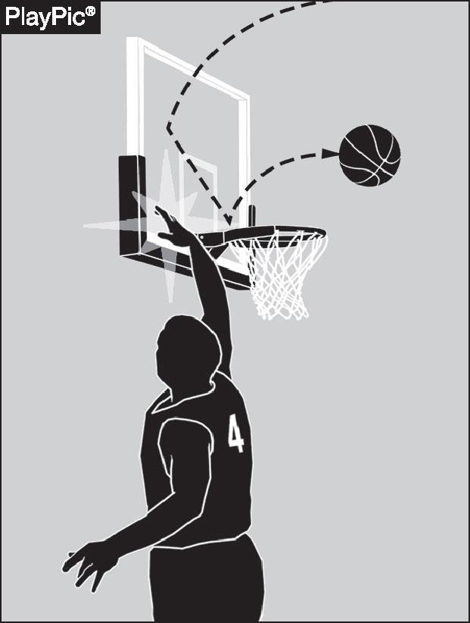
BASKET INTERFERENCE 4-6-2
EDITORIAL CHANGES
Occurs when a player slaps or strikes the backboard, causing the backboard or ring to vibrate during a try for goal that has the possibility of entering the basket
Notes:
Basket interference now covers slapping or striking the backboard, causing it or the ring to vibrate during a try that could score.
The old cylinder-specific language has been removed.

Slide 22
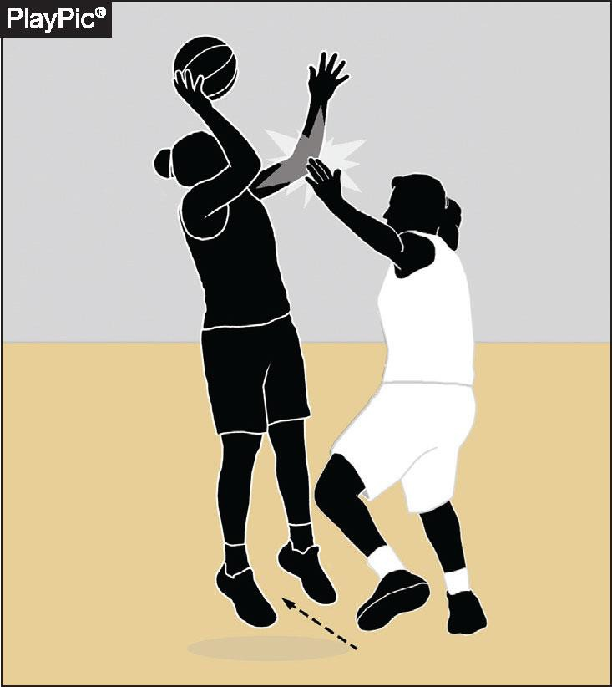
CONTINUOUS MOTION
EDITORIAL CHANGES
4.11.2 (SITUATION)
Stepping or pivoting toward the basket is not required to be considered in the act of shooting
A player may step in a direction that creates space in order to attempt a try, which may be lateral or away from the basket
Notes:
Stepping or pivoting toward the basket is not required to be in the act of shooting.
A player may step laterally or away to create space and still be considered shooting.

Slide 23
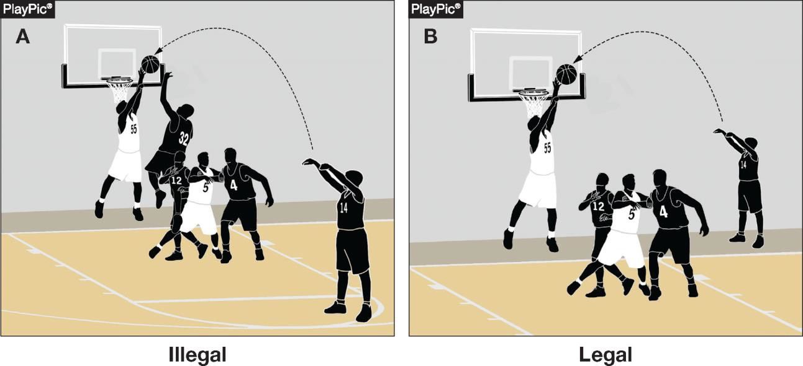
GOALTENDING
4-22-1 NOTE (NEW)
EDITORIAL CHANGES
When a defensive player touches a thrown or tapped ball while it is in its downward flight entirely above the basket, has the possibility of entering the basket and is not touching the basket cylinder
Goaltending does not apply to a ball released on a throw-in pass
Notes:
New note: goaltending is touching a ball in downward flight, entirely above the basket, with a chance to score, and not on the cylinder.
Goaltending does not apply to a ball released on a throw-in pass.

Slide 24
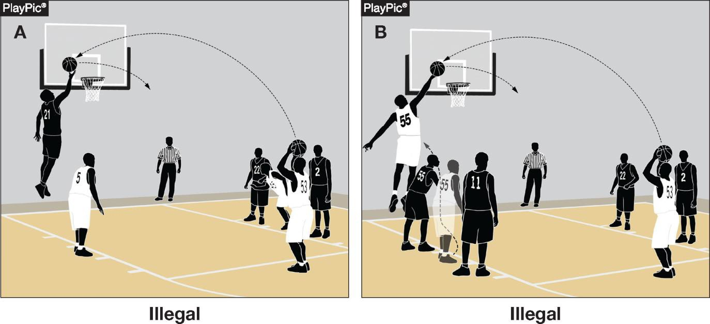
GOALTENDING 4-22-2
EDITORIAL CHANGES
When a player touches the ball outside the cylinder during a free-throw attempt
Committing goaltending during a free throw is also a player technical foul (see 10- 4-8)
Notes:
Touching the ball outside the cylinder during a free throw is goaltending.
On a free throw it is also a player technical foul (10-4-8).

Slide 25
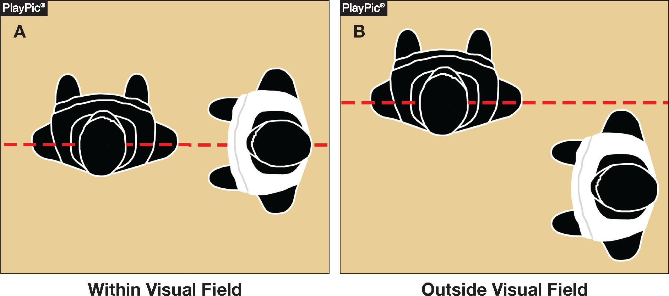
SCREEN
4-40-3 NOTE (NEW)
EDITORIAL CHANGES
The visual field of a player being screened includes the player’s forward vision and peripheral vision and extends horizontally from the ear
Notes:
The screened player's visual field includes forward and peripheral vision, measured horizontally from the ear.
Use this to judge how much time and distance a screener must give.

Slide 26
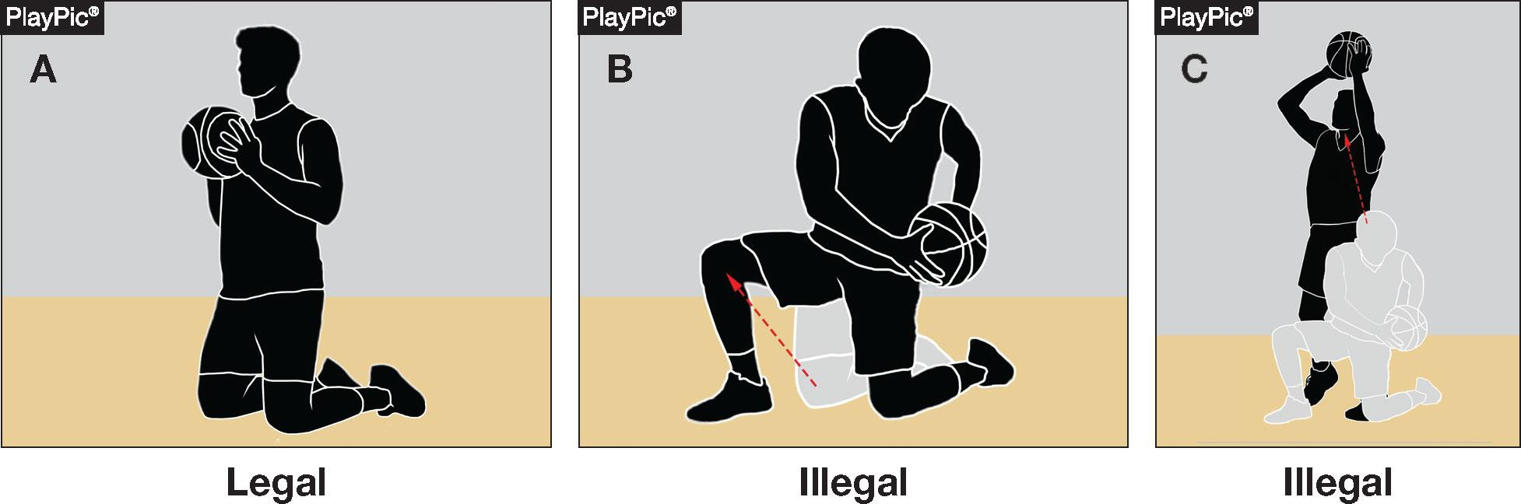
TRAVELING 4-44-5b
EDITORIAL CHANGES
A player holding the ball on the floor may not attempt to
stand up with the ball
Notes:
A player holding the ball on the floor may not attempt to stand up with it.

Slide 27
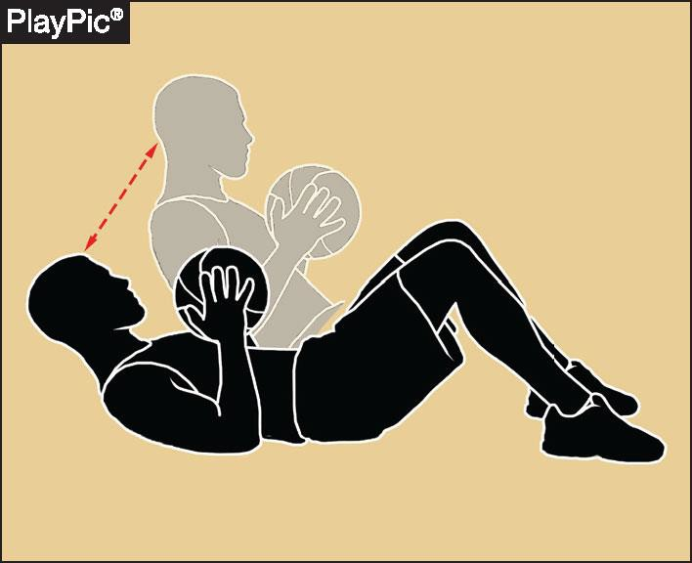
TRAVELING
EDITORIAL CHANGES
4.44.5 (SITUATION)
A player holding the ball flat on their back may sit up without traveling
The player may also return to a position on their back
Notes:
A player holding the ball flat on their back may sit up without traveling, and may return to their back.

Slide 28
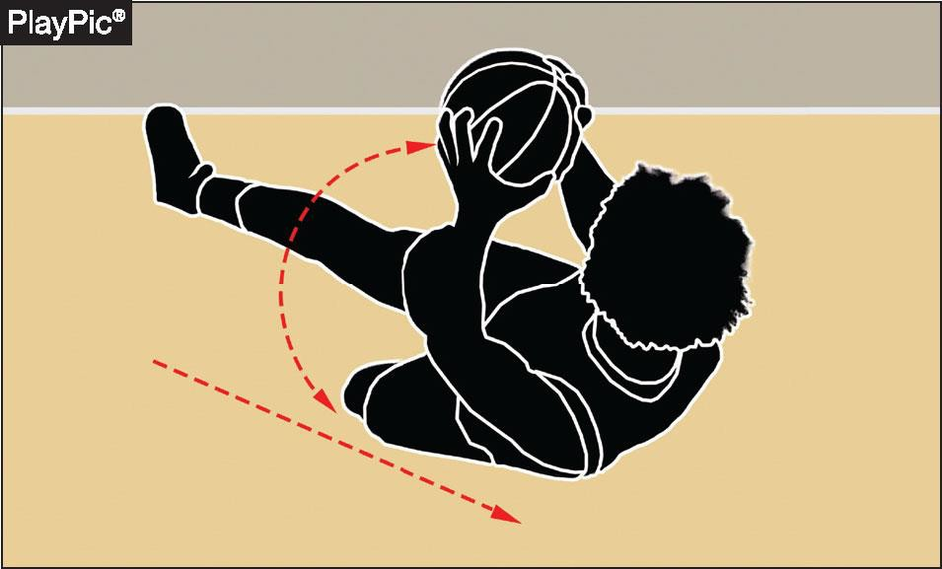
TRAVELING
4-44-5c (NEW)
EDITORIAL CHANGES
A player holding the ball… after gaining control while on the floor, may slide and/or roll with the ball if it is caused by the player’s momentum
Notes:
After gaining control while on the floor, a player may slide or roll with the ball if it is caused by their own momentum.

Slide 29
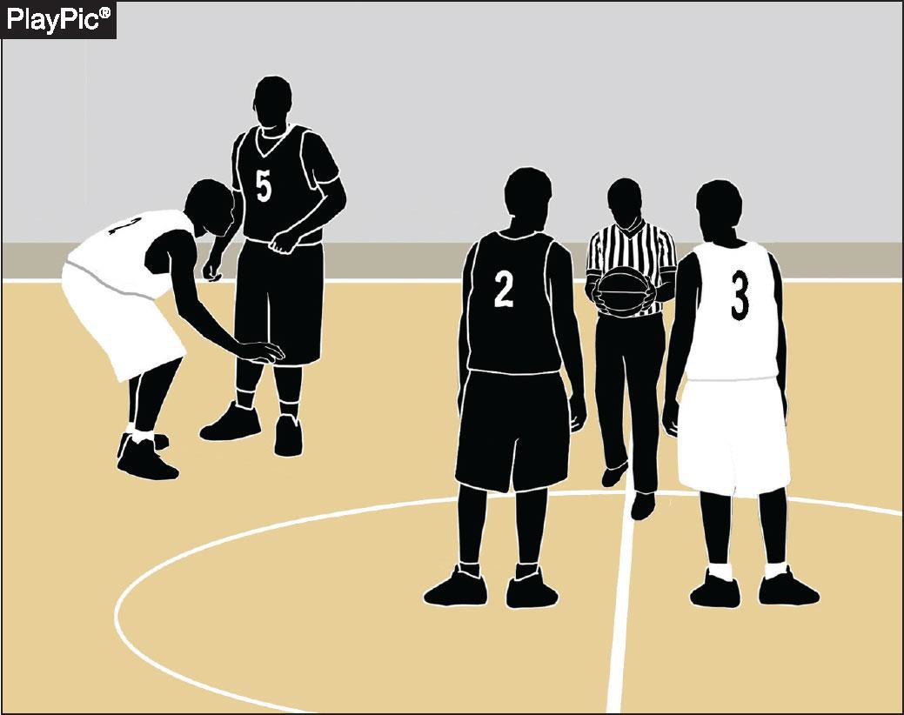
JUMP-BALL ADMINISTRATION 6-3-2
EDITORIAL CHANGES
“When the official enters the center restraining circle” has
replaced the former language “is
ready”
Notes:
'When the official enters the center restraining circle' replaces the former 'is ready' language.
This defines the trigger point for jump-ball restrictions.

Slide 30
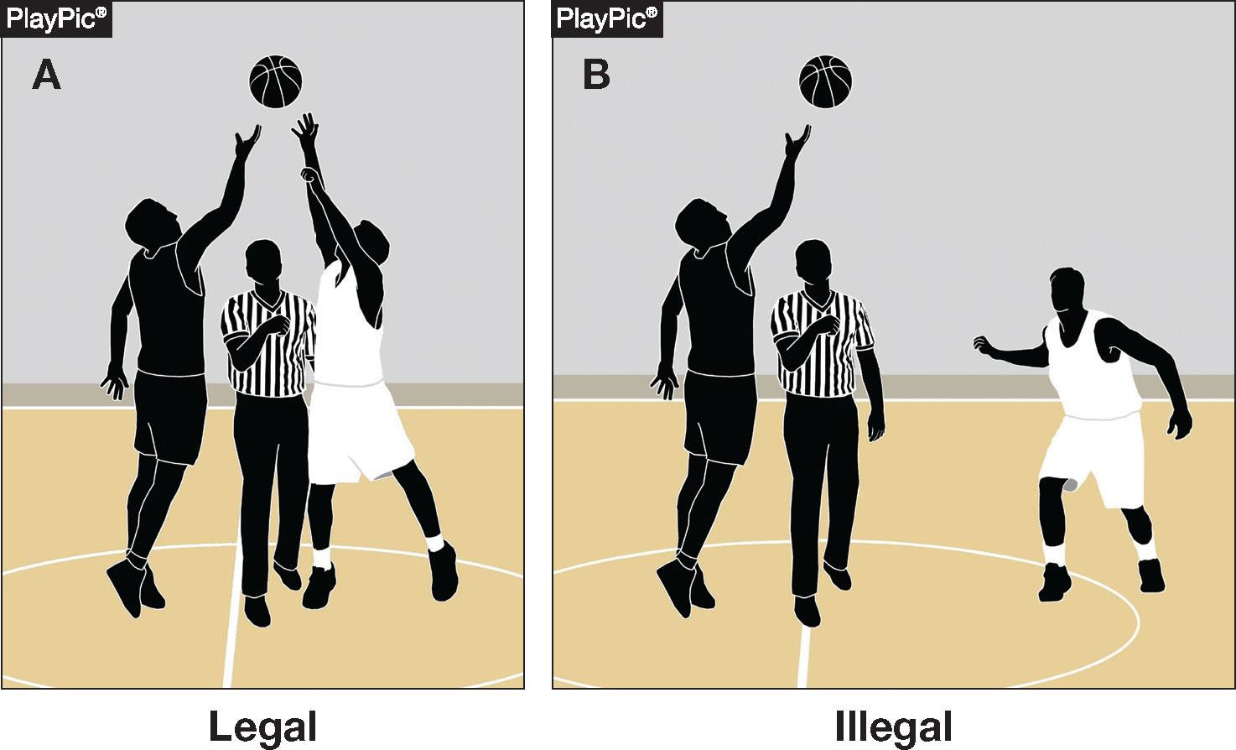
JUMP-BALL ADMINISTRATION 6-3-4 NOTE (NEW)
EDITORIAL CHANGES
Each jumper shall have both feet within their half of the center restraining circle until the jump-ball ends
The restrictions end when the ball is touched by one or both jumpers
Notes:
Each jumper must keep both feet within their half of the center restraining circle until the jump-ball ends.
The restriction ends when the ball is touched by one or both jumpers.

Slide 31
RESUMPTION-OF-PLAY PROCEDURE, THROW-INS
7-5-6c (NEW)
EDITORIAL CHANGES
When a throw-in violation occurs during a division line throw-in, the resulting throw-in shall remain at the division line opposite the scorer’s and timer’s table
Clarifies that in this situation, the throw-in would not be moved to one of the eight designated spots to resume play
Notes:
A throw-in violation during a division-line throw-in keeps the throw-in at the division line opposite the table.
It is not moved to one of the eight designated spots.

Slide 32
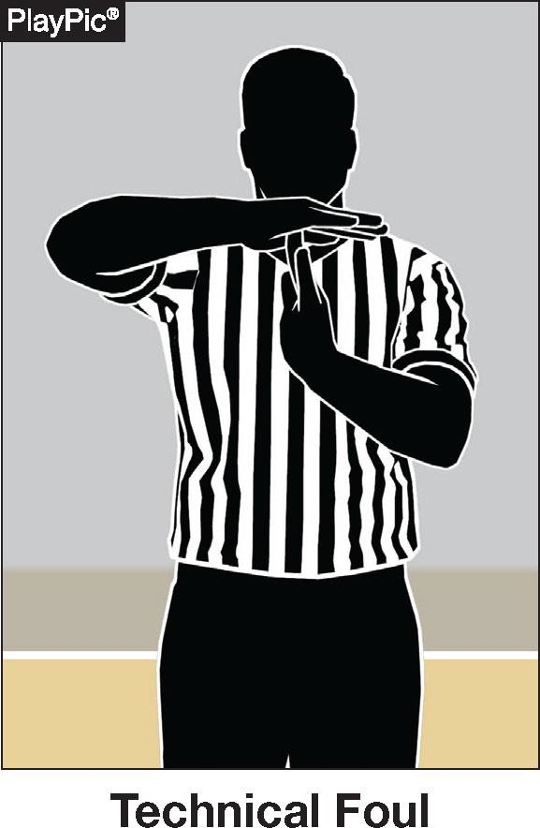
TECHNICAL FOUL
PENALTY SUMMARY CHART
EDITORIAL CHANGES
The Technical Foul Penalty Summary chart has been revised to better align with Rule 10
Notes:
The Technical Foul Penalty Summary chart is revised to better align with Rule 10.
Use it as a quick on-court reference.

Slide 33
2026 Points of Emphasis
Notes:
Transition slide: these are the 2026 points of emphasis, areas that need consistent enforcement.

Slide 34
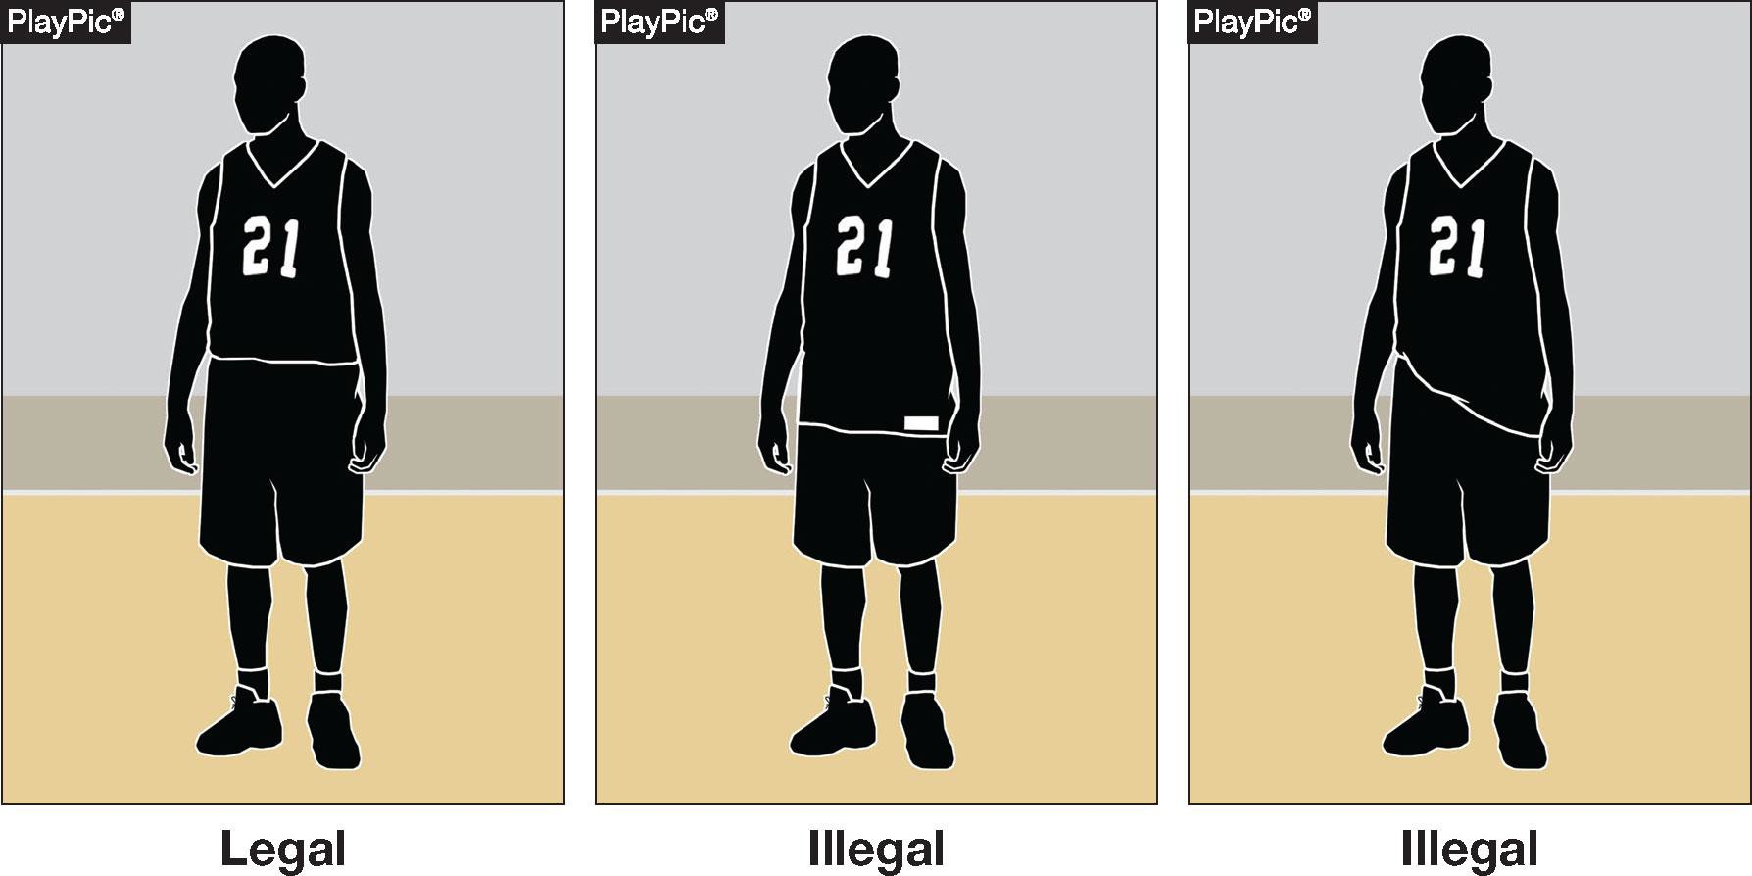
UNIFORMS
POINTS OF EMPHASIS
Uniforms shall be worn in the manner the manufacturer intended
Players not in compliance with Rule 3-3-5 shall be directed to leave the game until corrected (as outlined in Rule 3-3-4)
Notes:
Uniforms must be worn in the manner the manufacturer intended.
Players not in compliance with 3-3-5 are directed to leave the game until corrected.

Slide 35
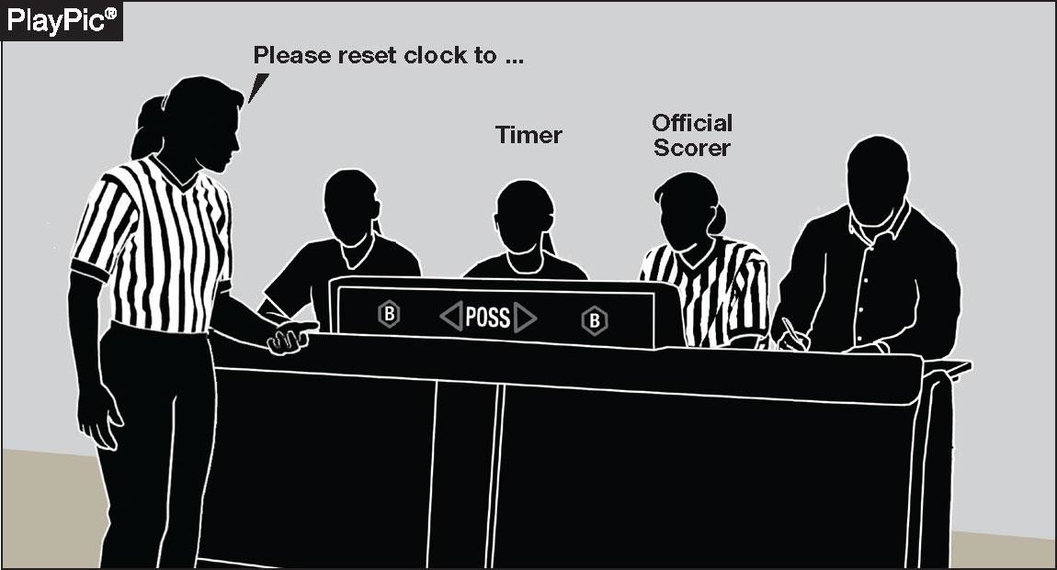
TIMING MISTAKES / OFFICIALS’ COUNTS
POINTS OF EMPHASIS
Accurate timing is essential to game integrity and competitive balance
Officials and table personnel must work collaboratively
Notes:
Accurate timing is essential to game integrity and competitive balance.
Officials and table personnel must work collaboratively.

Slide 36
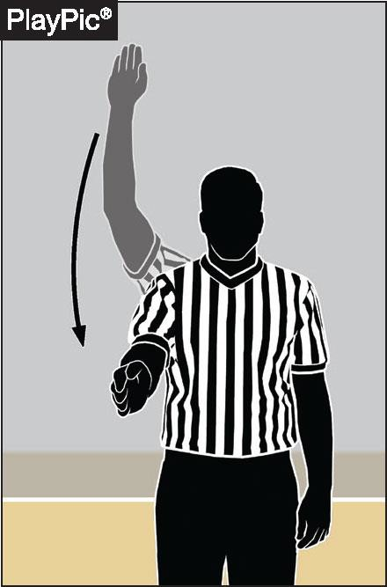
TIMING MISTAKES / OFFICIALS’ COUNTS
POINTS OF EMPHASIS
When timing mistakes or equipment issues occur, officials may utilize visible or silent counts
Strong communication between officials and
the scorer’s table is essential
Notes:
When timing mistakes or equipment issues occur, officials may use visible or silent counts.
Strong communication between officials and the scorer's table is essential.

Slide 37
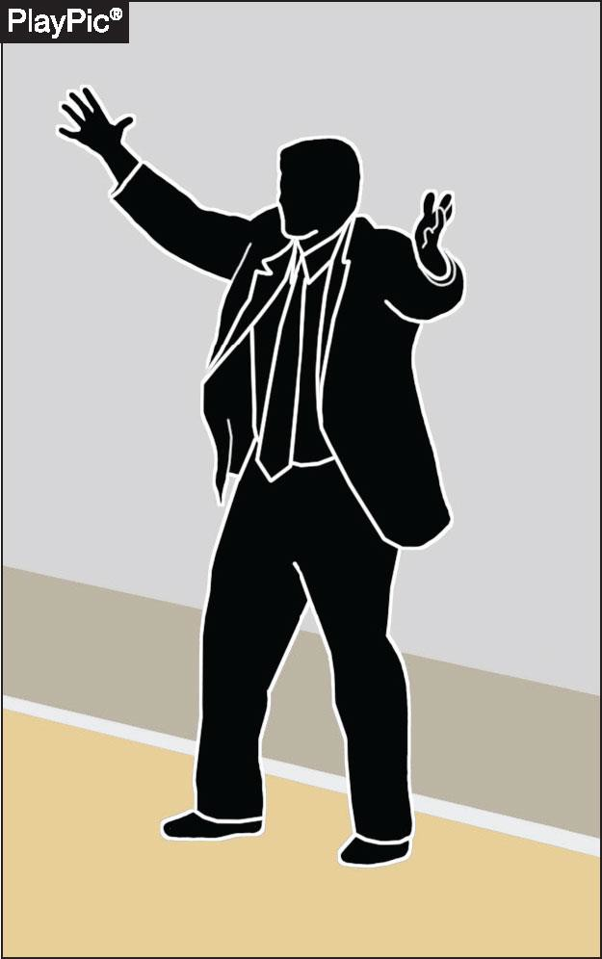
BENCH DECORUM / SPORTSMANSHIP / PROFESSIONAL CONDUCT
POINTS OF EMPHASIS
Sportsmanship is a core expectation of education-based basketball
Consistent professionalism, respect and sportsmanship is required from coaches, players and officials
Notes:
Sportsmanship is a core expectation of education-based basketball.
Consistent professionalism, respect, and sportsmanship are required from coaches, players, and officials.

Slide 38
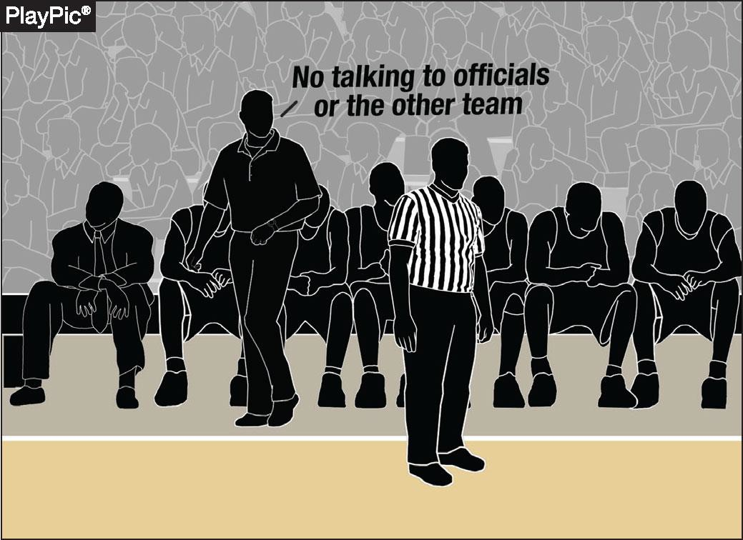
BENCH DECORUM / SPORTSMANSHIP / PROFESSIONAL CONDUCT
POINTS OF EMPHASIS
The head coach is responsible for all bench personnel and communication with officials
Taunting (actions or remarks intended to embarrass, ridicule or demean an opponent) has no place in high school basketball and must be addressed promptly and consistently per NFHS rules
Notes:
The head coach is responsible for all bench personnel and communication with officials.
Taunting has no place in high school basketball and must be addressed promptly and consistently.

Slide 39
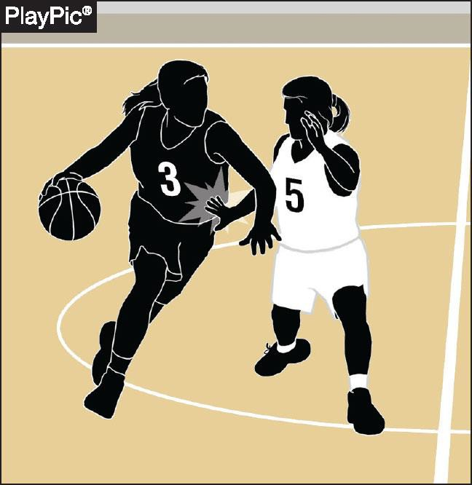
PHYSICAL PLAY / ILLEGAL CONTACT
POINTS OF EMPHASIS
Unnecessary or illegal contact creates disadvantage and safety concerns
Officials, coaches and players must collectively ensure legal play is distinguished from illegal physical advantage
Illegal contact includes hand checking, displacement, push-offs using the controlling arm and other actions that restrict freedom of movement or violate legal guarding principles
Notes:
Unnecessary or illegal contact creates disadvantage and safety concerns.
Officials, coaches, and players must distinguish legal play from illegal physical advantage.
Watch hand checking, displacement, and push-offs with the controlling arm.

Slide 40
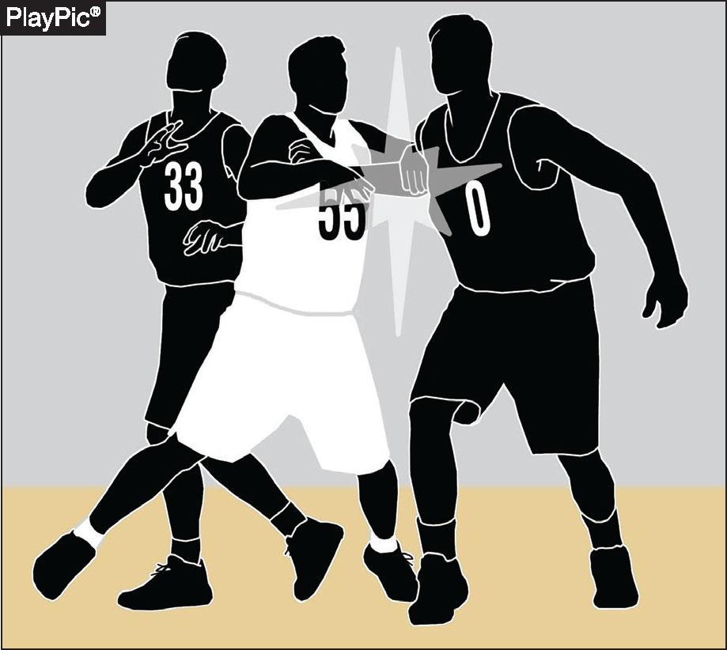
PHYSICAL PLAY / ILLEGAL CONTACT
POINTS OF EMPHASIS
Unnecessary roughness or overly aggressive contact must be penalized to maintain safety and game control
Post play requires special attention, including illegal use of two hands on the back, forearm displacement or dislodging a legally positioned opponent
Notes:
Unnecessary roughness or overly aggressive contact must be penalized to keep the game safe and controlled.
Give post play special attention: two hands on the back, forearm displacement, or dislodging a legal opponent.

Slide 41
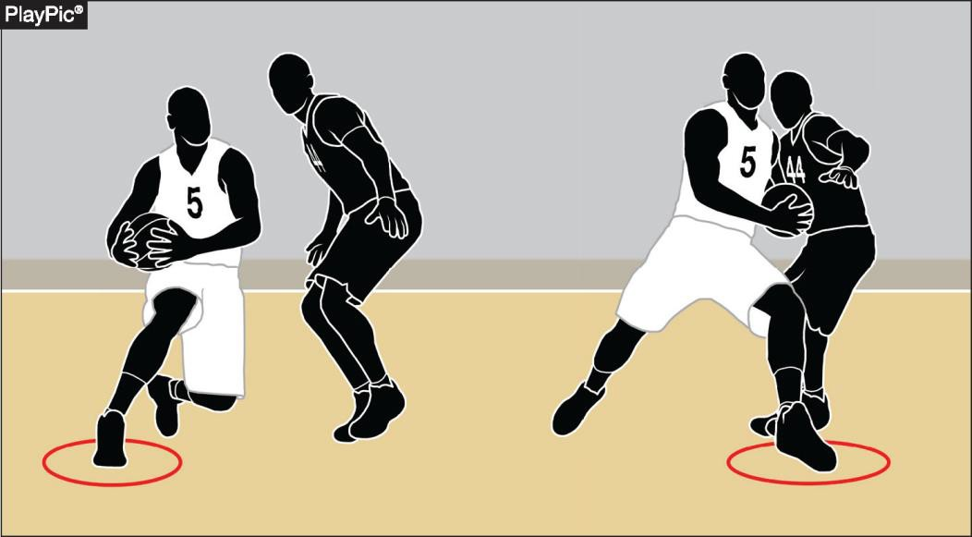
TRAVELING / CONTINUOUS MOTION / LEGAL PLAYER MOVEMENT
POINTS OF EMPHASIS
Proper enforcement of traveling and continuous motion continues to be of high priority to the committee
Moves such as Euro-steps, spin moves and jump stops are legal when executed within the limits of establishing and maintaining a pivot foot
Notes:
Proper enforcement of traveling and continuous motion remains a high priority for the committee.
Euro-steps, spin moves, and jump stops are legal when done within pivot-foot limits.

Slide 42
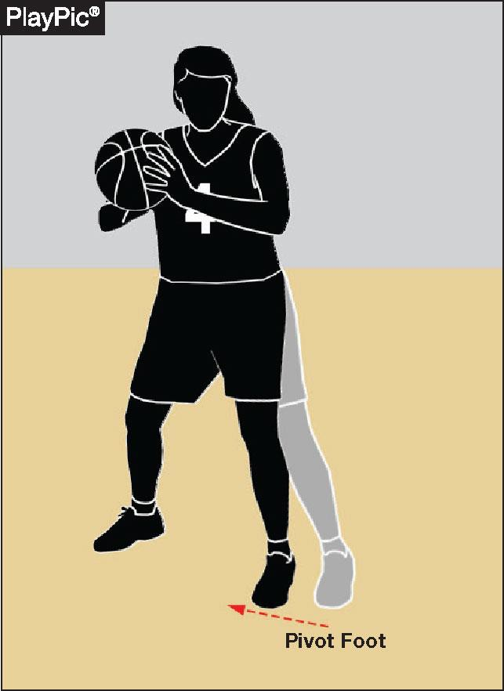
TRAVELING / CONTINUOUS MOTION / LEGAL PLAYER MOVEMENT
POINTS OF EMPHASIS
Dragging a pivot foot, taking extra steps or failing to properly maintain a pivot foot constitutes traveling
A player who is fouled after starting a try or tap for field goal is permitted to complete the customary arm movement, and if pivoting or stepping when fouled, may complete the usual foot or body movement
Continuous motion ends when the ball is clearly in flight
Notes:
Dragging the pivot foot, taking extra steps, or failing to maintain the pivot is traveling.
A player fouled after starting a try may complete the customary arm and foot movement.
Continuous motion ends when the ball is clearly in flight.

Slide 43
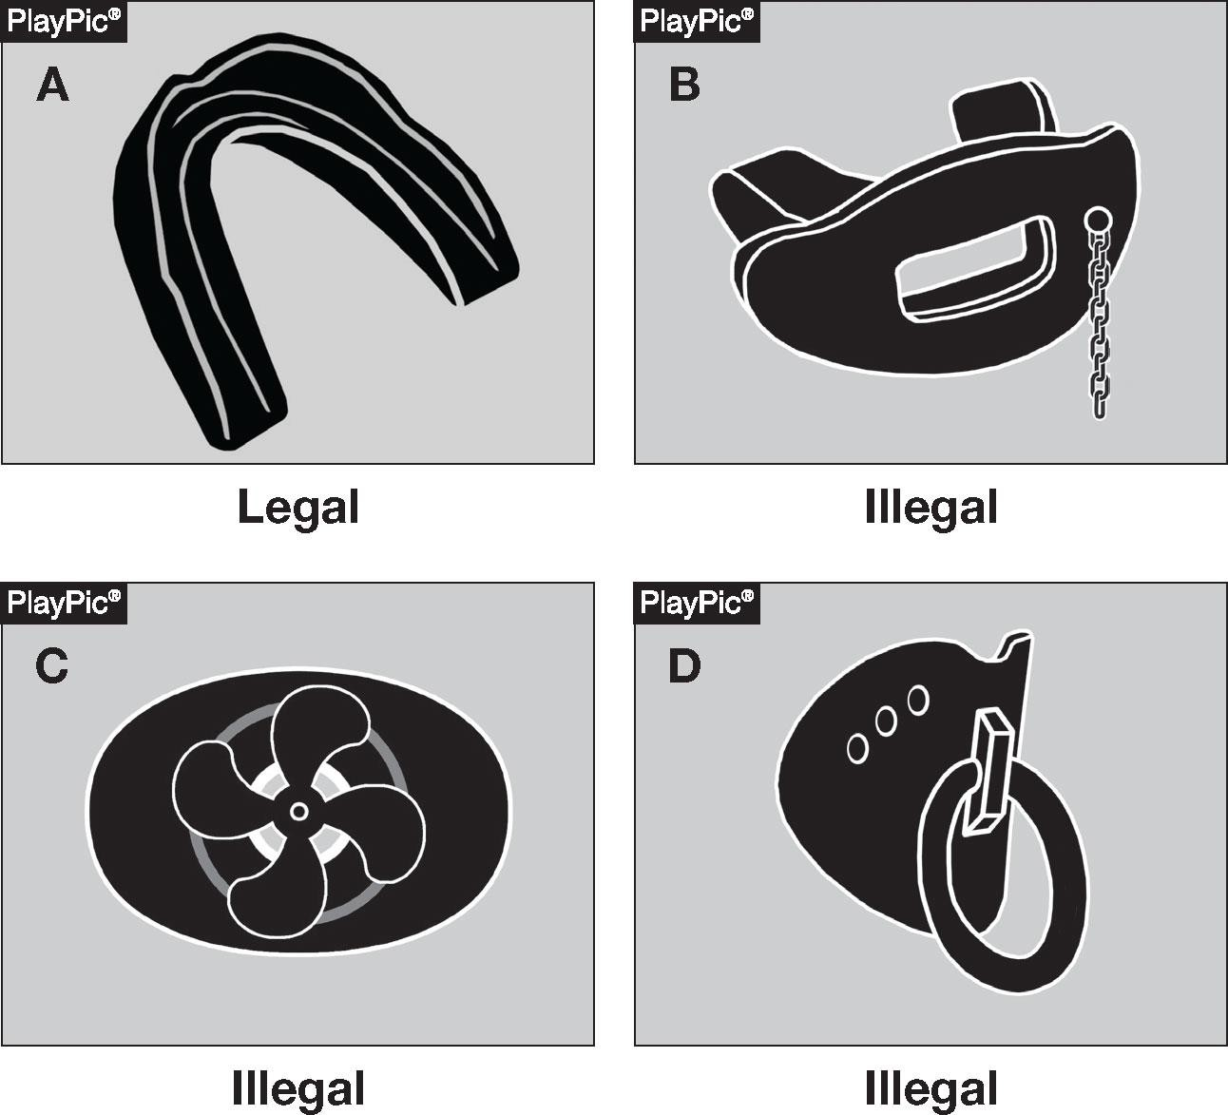
PLAYER EQUIPMENT:
TOOTH AND MOUTH PROTECTORS
POINTS OF EMPHASIS
Tooth and mouth protectors must be worn as intended for protective purposes
Protectors must not include attachments or features unrelated to protection
Notes:
All protectors must be properly molded or custom fitted and worn as designed for their protective function. Protectors may not include any attachments or features that do not serve a protective purpose or that create additional safety risks. The overarching goal is to maintain player safety and minimize injury risk on the field.

Slide 44


AUTHENTICATING MARK
POINTS OF EMPHASIS
The NFHS Authenticating Mark ensures easy identification of inflated and non-inflated balls used in interscholastic competition for which the NFHS writes playing rules
All such balls are required to display the NFHS Authenticating Mark
Notes:
The NFHS Authenticating Mark identifies legal inflated and non-inflated game balls.
All such balls are required to display the mark.

Slide 45
NFHS Learning Center
Notes:
Transition slide: now covering the NFHS Learning Center.

Slide 46


The National Leader
100+ Online Courses
75+ Available at No Cost!
Active in All 50 States
Valuable Professional Development
Earn Completion Certificates
Earn National Credentials
Earn Badges
www.nfhslearn.com
Notes:
NFHS Learning Center, the National Leader:
• The NFHS Learning Center is the home for online professional development across the entire interscholastic community — coaches, students, officials, parents, administrators, and performing arts staff.
• Offers: 100+ courses available, with 75+ offered at no cost, and active engagement in all 50 states.
• Participants earn completion certificates, national credentials, and badges that support their professional growth.
• Direct the audience to www.nfhslearn.com to browse and enroll.

Slide 47


Over 29 million courses delivered!
Concussion in Sports – 9.2M+
Heat Illness Prevention – 3.6M+
Sudden Cardiac Arrest – 3.9M+
Concussion for Students – 2.1M+
The Collapsed Student (2020) – 108,000+
CPR & AED Training (2023) – 55,500+
Sportsmanship – 1.7M+
Fundamentals of Coaching – 1.1M+
First Aid, Health and Safety – 505,000+
Bullying, Hazing and Inappropriate Behaviors – 658,000+
Student Mental Health and Suicide Prevention – 460,000+
Coaching Mental Wellness (2025) – 37,750+
Emergency Action Planning for Afterschool Programs (2025) – 14,600+
Notes:
The NFHS Learning Center has now delivered more than 29 million course completions across the interscholastic community.
• The flagship safety courses driving the bulk of that volume — Concussion in Sports at 9.2M+, Sudden Cardiac Arrest at 3.9M+, Heat Illness Prevention at 3.6M+, and Concussion for Students at 2.1M+.
• Broad-impact education courses: Sportsmanship (1.7M+), Fundamentals of Coaching (1.1M+), Bullying, Hazing & Inappropriate Behaviors (658K+), First Aid Health and Safety (505K+), and Student Mental Health & Suicide Prevention (460K+).

Slide 48

NFHS Network
Notes:
Transition slide: now covering the NFHS Network streaming platform.

Slide 49
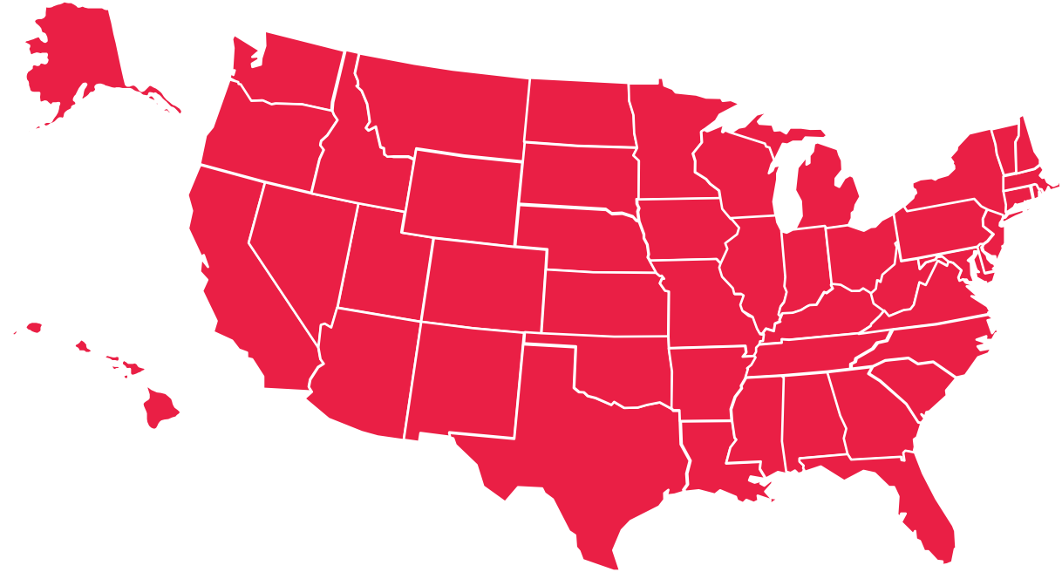
NFHS Network
27 Different Sports and Activities.
By 2028, every high school event in America will be streamed live.
The NFHS Network will be
THE DESTINATION for fans.
OUR NETWORK
www.NFHSnetwork.com
Notes:
• The NFHS Network is the website and app where fans can watch live and replay high school sports and activities.
• 27 different sports and activities are featured on the platform today.
• By 2028, every high school event in America will be streamed live.
• Position the Network as THE DESTINATION for high school sports fans and direct them to www.NFHSnetwork.com.

Slide 50

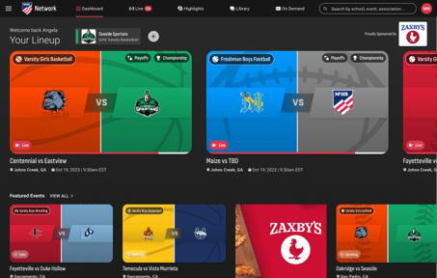
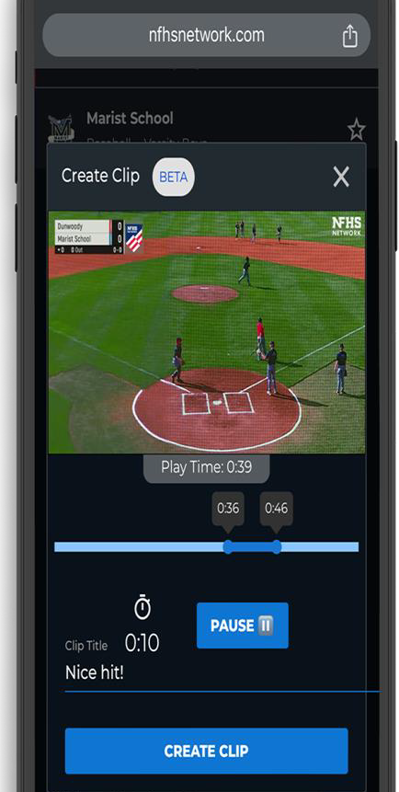
Capture Your Memories –
Clip and Share
Allowing fans to capture and share their favorite moments
Notes:
Capture Your Memories, Clip and Share:
• Clip-and-share feature lets fans capture their favorite moments straight from a broadcast and share them on social.
• The NFHS Network will broadcast over 750,000 live events this year.
• Opportunity for athletes, families, and alumni to relive standout plays with just a few taps.
• If a school isn’t yet part of the NFHS Network School Broadcast Program, direct them to Mark.Koski@NFHSnetwork.com.

Slide 51
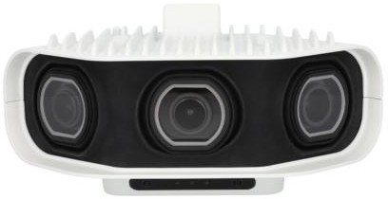







Automated Content Platform: Summary
Live Stream
VOD
+ VOD
Pixellot Camera
Coaching Platform
Game Breakdown
100%
Automated
Score, Team Stats, Player Stats
Short Form Videos
Notes:
Automated Content Platform Summary & ecosystem partners:
• Position the NFHS Network as the central platform for the high school fan experience, powered by 100% automated Pixellot camera capture.
• Offering live stream plus VOD, integrated coaching platform, game breakdown, score and team/player stats, and auto-generated short-form videos.
• Together these platforms create a connected experience for fans, families, schools, and communities — making events easier to access, follow, and engage with before, during, and after the game.

Slide 52


Notes:
• The NFHS Network, MaxPreps, PlayOn, and GoFan work together as one connected platform for high school athletics.
• Streaming, schedules and scores, ticketing, and content/stats — the full ecosystem at a glance.
• Fans, families, schools, and communities get a single, integrated experience for following high school events.

Slide 53
NFHS Store

Slide 54

NFHS Store
We’re excited to introduce a new NFHS Store, powered by Northwest Designs, making it easier than ever to shop NFHS-branded apparel and have it delivered straight to your home or office. The collection features t-shirts, polos, sweatshirts, and quarter-zips from top brands like Nike and Gildan. We can’t wait to see our membership proudly representing the NFHS brand!
https://online-apparel.com/s/nfhs-merchandise/
Notes:
• Introduce the new NFHS Store, powered by Northwest Designs, as an easier way to shop NFHS-branded apparel with delivery straight to home or office.
• Buy t-shirts, polos, sweatshirts, and quarter-zips from top brands like Nike and Gildan.
• Encourage attendees and their organizations to proudly represent the NFHS brand at events, meetings, and on the field.
• Direct everyone to online-apparel.com/s/nfhs-merchandise to browse and order.

Slide 55

Thank You
National Federation of State High School Associations
NFHS.org
Phone # 317-972-6900
@NFHS1920
Email mmaxwell@nfhs.org
@NFHS_org
Notes:
Thank the attendees for their time and engagement.
Direct questions to Monica Maxwell (mmaxwell@nfhs.org, 317-972-6900) and encourage following @NFHS_org.

